Slide 1
Release and Sprint Planning

Slide 2
Release Planning
Release planning is longer term planning which allows you to answer:
  “When will we be done?”
  “Which features can I get by the end of this quarter/year?”
Release planning balances customer value and overall quality against the constraints of scope, schedule, and budget
Release planning enables organizations to make informed investment decisions. It sets expectations, aligns stakeholder and development teams and allows product people to guide the work of the development team
Notes:
Let’s talk about velocity
It simply is the average number of story points a team can complete per sprint
Releasing quality software is our measure of productivity

Slide 3
Release Planning
Release planning involves:
Establishing clear, specific, and measurable goals. These are either product or release goals and captured on the product roadmap
Determining the work to be done. Usually involves high-level estimates
Understanding date and budget constraints. Are there any hard deadlines that must be met or is the budget fixed?
Monitoring progress from sprint to sprint and making adjustments as required
Release planning takes place at 2 levels: across several releases and within a single release
Notes:
Let’s talk about velocity
It simply is the average number of story points a team can complete per sprint
Releasing quality software is our measure of productivity

Slide 4
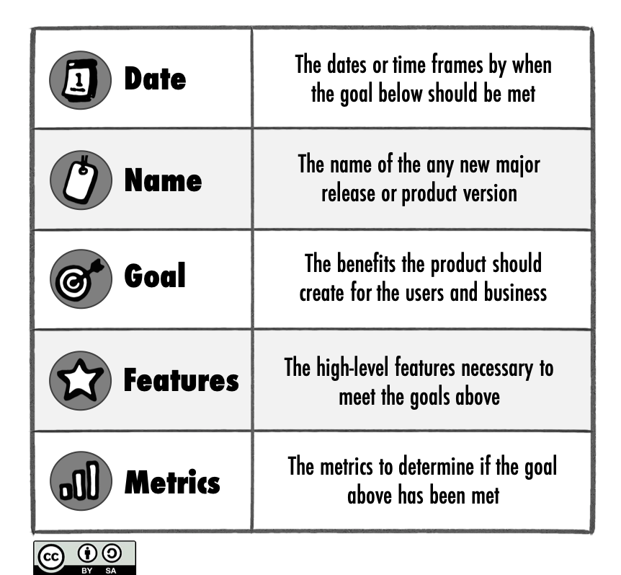
Product Roadmap
A product roadmap can represent the release planning across several major releases
A good way to do a roadmap is a goal-oriented or Go Product Roadmap
https://www.romanpichler.com/tools/the-go-product-roadmap/

Slide 5
Planning a Single Release
Organizations must decide the proper cadence for releasing features to customers.
  Release after multiple sprints
  Release every sprint
  Release every feature
Many organizations choose not to release new features after every sprint. Instead the results of multiple sprints are combined into one release
Some organizations use continuous deployment and do not even wait until the end of the sprint to release a feature, they release it as soon as completed
Notes:
Let’s talk about velocity
It simply is the average number of story points a team can complete per sprint
Releasing quality software is our measure of productivity

Slide 6
Timing of Release Planning
Release planning is not a once and done event, but should occur with every sprint
Initial release planning follows product level planning. The purpose of product level planning is to envision what the product should be; the aim of release planning is to determine the next logical step toward achieving that product goal
Before starting a release, some organizations conduct initial release planning to create a prelim release plan. This activity might last a day or two
As validated learning becomes available during the release, the release plan is updated
Release plans can be revised as part of the sprint review
Notes:
Let’s talk about velocity
It simply is the average number of story points a team can complete per sprint
Releasing quality software is our measure of productivity

Slide 7
Process of Release Planning
Input to release planning includes the outputs from product planning such as product vision, high level product backlog, and product roadmap
Another input into the release planning process is velocity of the team
Notes:
Let’s talk about velocity
It simply is the average number of story points a team can complete per sprint
Releasing quality software is our measure of productivity

Slide 8
Velocity Definition
Velocity: average amount of work a Scrum Team can complete per sprint
Velocity is NOT a measure of the team’s productivity
The amount of work can be grouped based on the estimating method. For example velocity might be defined as a number of story points, a number of hours or days, or a number of different sized items (i.e. 1 medium and 2 large)
For purposes of release planning (including continuous release planning) velocity is a good guide, however the best way to determine if a sprint is success if is if the sprint goal was met NOT if the velocity was met.
Notes:
Let’s talk about velocity
It simply is the average number of story points a team can complete per sprint
Releasing quality software is our measure of productivity

Slide 9
Velocity (cont)
Goal - increase team velocity to highest level possible
Variations:
  Will be more variable at first
  Team will form/storm/norm/perform
  Optimize and smooth out over time
  Add, remove or change team members
  Add, remove or swap out functionality
  Velocity
  https://www.youtube.com/watch?v=Nk0xH6bISeE
  (length 2:45)
Notes:
It is important to get the right balance of talent and skills on a scrum team
Idea is to get cross training of skills
Team members are always learning from each other and learning new things on their own
Cross skill pollination is really encouraged and coached by the ScrumMaster
It is not typical to constantly change team members on a scrum team
It is best to keep a scrum team together because there is time for forming/norming/storming/performing
Team is typically at the optimal velocity once the team is in performing stage

Slide 10
Process of Release Planning
Along with velocity the release constraints of scope, date, and budget need to be reviewed to see if any changes should be made.
Each release should have a Minimum Releasable Feature (MRF)
Notes:
Let’s talk about velocity
It simply is the average number of story points a team can complete per sprint
Releasing quality software is our measure of productivity

Slide 11
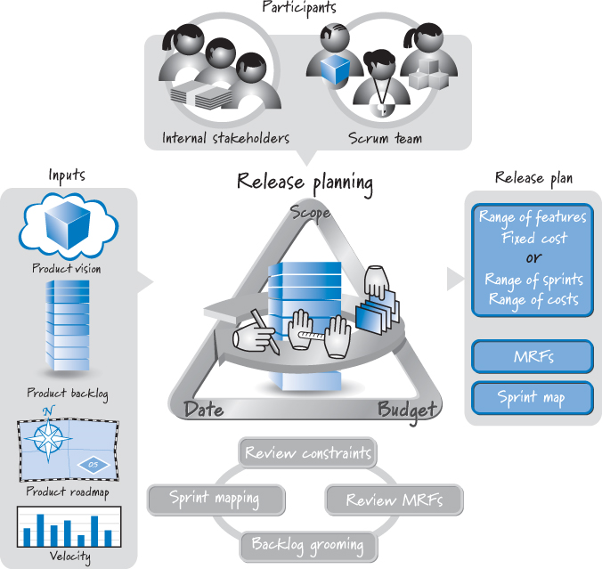
Release Planning in Scrum

Slide 12
Release Constraints
The goal of release planning is to determine what constitutes the most valuable next release and what the desired level of quality is.
The constraints of scope, date, and budget are important variables that affect how the goal is achieved
Based on product planning, one or more of these constraints will be established
You can have: fixed everything, fixed scope and date, fixed scope, fixed date. Fixed everything and fixed scope and date are not recommended.
Notes:
Let’s talk about velocity
It simply is the average number of story points a team can complete per sprint
Releasing quality software is our measure of productivity

Slide 13
Fixed Scope
Fixed scope is appropriate where the scope truly is more important than the date.
In this model, if the team runs out of time before the features have been completed, the date is extended to ensure everything required to meet the MRFs are done
Frequently a fixed-scope scenario exists because the overall scope is too large. A better solution might be to consider smaller, more frequent fixed-date releases
In organizations where multiple groups such as development, marketing, support must coordinate activities moving the date can be very disruptive to the other groups
Notes:
Let’s talk about velocity
It simply is the average number of story points a team can complete per sprint
Releasing quality software is our measure of productivity

Slide 14
Fixed Date
Many consider this approach to be the one most closely aligned with Scrum principles.
The date and budget are fixed and the scope must be flexible
The Scrum principle of creating the highest-priority features first should lessen any perceived pain of having to drop features
When we run out of time whatever has not yet been built should be of lower value than what has already been built. It is a much easier decision to ship if the features that are missing are low value
This works only when the high-priority features are truly done, based on the definition of done
Notes:
Let’s talk about velocity
It simply is the average number of story points a team can complete per sprint
Releasing quality software is our measure of productivity

Slide 15
Steps for Fixed Scope Release Planning
Groom the product backlog to include at least the product backlog items you would like in the release by creating, estimating the size of, and prioritizing the product backlog items
  Since this is fixed scope, need to determine what is in the fixed scope
Determine the total size of the product backlog items to be delivered in the release
Measure or estimate the team’s velocity as a range
Divide the total size of the product backlog items by the faster velocity and round up the answer to the integer. This will tell the lowest number of sprints required
Divide the total size of the product backlog items by the slower velocity and round up the answer to the next integer. This will tell the highest number of sprint required
Notes:
Let’s talk about velocity
It simply is the average number of story points a team can complete per sprint
Releasing quality software is our measure of productivity

Slide 16
Steps for Fixed Date Release Planning
Determine how many sprints are in the release
  If all sprint lengths are equal this is just calendar math
Groom the product backlog to a sufficient depth by creating, estimating the size of, and prioritizing product backlog items
  Need enough product backlog items to plan out to the fixed date
Measure or estimate the team’s velocity as a range
Multiply the slower velocity by the number of sprints, count down that number of points into the product backlog and draw a line (will have above)
Multiply the faster velocity by the number of sprints, count down that number of points into the product backlog and draw a line (might have above)
Notes:
Let’s talk about velocity
It simply is the average number of story points a team can complete per sprint
Releasing quality software is our measure of productivity

Slide 17
Release Burndown Chart
The release burndown chart is a visual way to see the remaining effort towards the release at the end of each sprint
Start by estimating the total amount of the product backlog items that should be part of the release (could be in story points, just number of items, hours, days, etc.)
Plot the total number on the y axis of an x and y axis and label the x axis with the sprints that are expected in the release. Draw a line from the total number to the end of the sprints, this is the ideal line. At the end of each sprint you will plot the remaining effort and draw a line from sprint to sprint. This is the burndown.
The burndown shows the rate at which the effort in the product backlog is consumed. It is influenced by two factors: changes in the product backlog and the development team’s velocity.
Extending the burndown line to the horizontal axis allows you to forecast when the development effort is likely to finish or if you are likely to reach the release goal by delivering all relevant product backlog items at a specific date

Slide 18
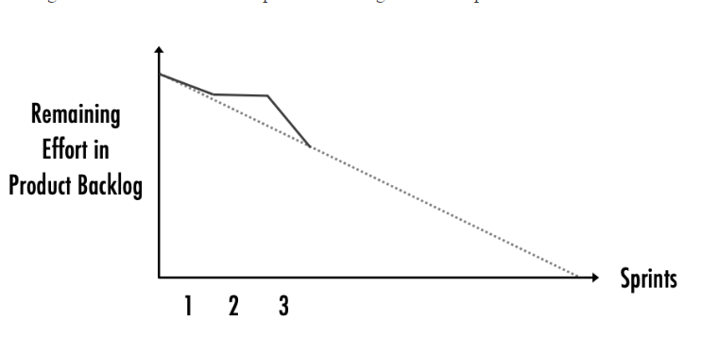
Release Burndown Chart
https://www.linkedin.com/pulse/release-planning-advice-roman-pichler/

Slide 19
Product Backlog Grooming
A fundamental activity of release planning is grooming the product backlog to meet our value and quality objectives.
During product planning many epics or high level product backlog items may be created but are too large to be useful during release planning
A user story writing workshop will help to decrease the size of the epics or high level product backlog items
Once stories are small enough the team can estimate them to communicate a rough idea of the cost
Once user stories are estimated and prioritized they can be planned in the release based on the release goal and constraints
Notes:
Let’s talk about velocity
It simply is the average number of story points a team can complete per sprint
Releasing quality software is our measure of productivity

Slide 20
Sprint Mapping
Some teams believe a quick early mapping (or slotting) of product backlog items into sprints is helpful
Mapping out a few sprints in a multiteam environment might help the teams to better coordinate their work
Start with appropriately detailed, estimated, and prioritized product backlog
Using the team’s velocity approximate a set of product backlog items for each sprint by grouping together items whose aggregated size roughly equals the team’s average velocity
The result will be a listing of sprints with their mapped product backlog items (user stories)
Notes:
Let’s talk about velocity
It simply is the average number of story points a team can complete per sprint
Releasing quality software is our measure of productivity

Slide 21

Sprint Definition
An iteration of work during which an increment of product functionality is implemented
Usually time boxed to 2-4 weeks
Sprint 0
Sprint 1
Sprint 2
Notes:
So remember the definition of a sprint…

Slide 22
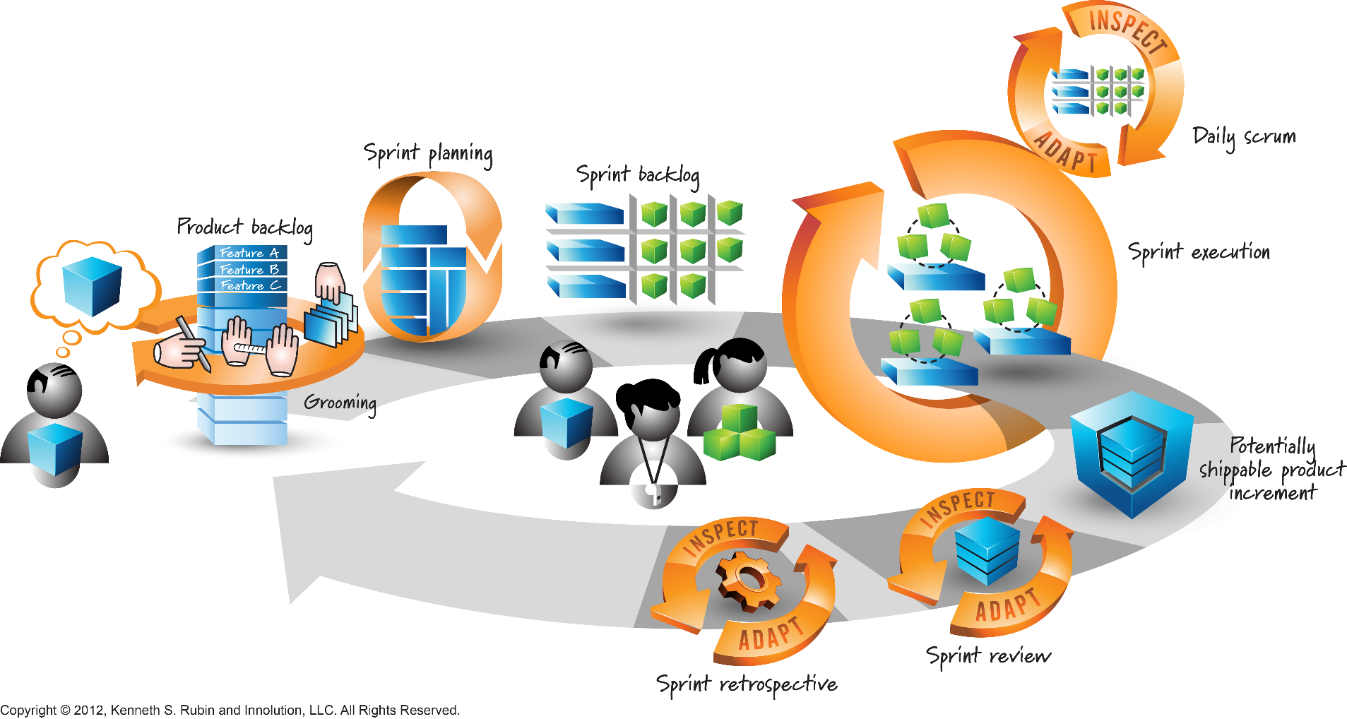
Sprint Planning in Scrum

Slide 23
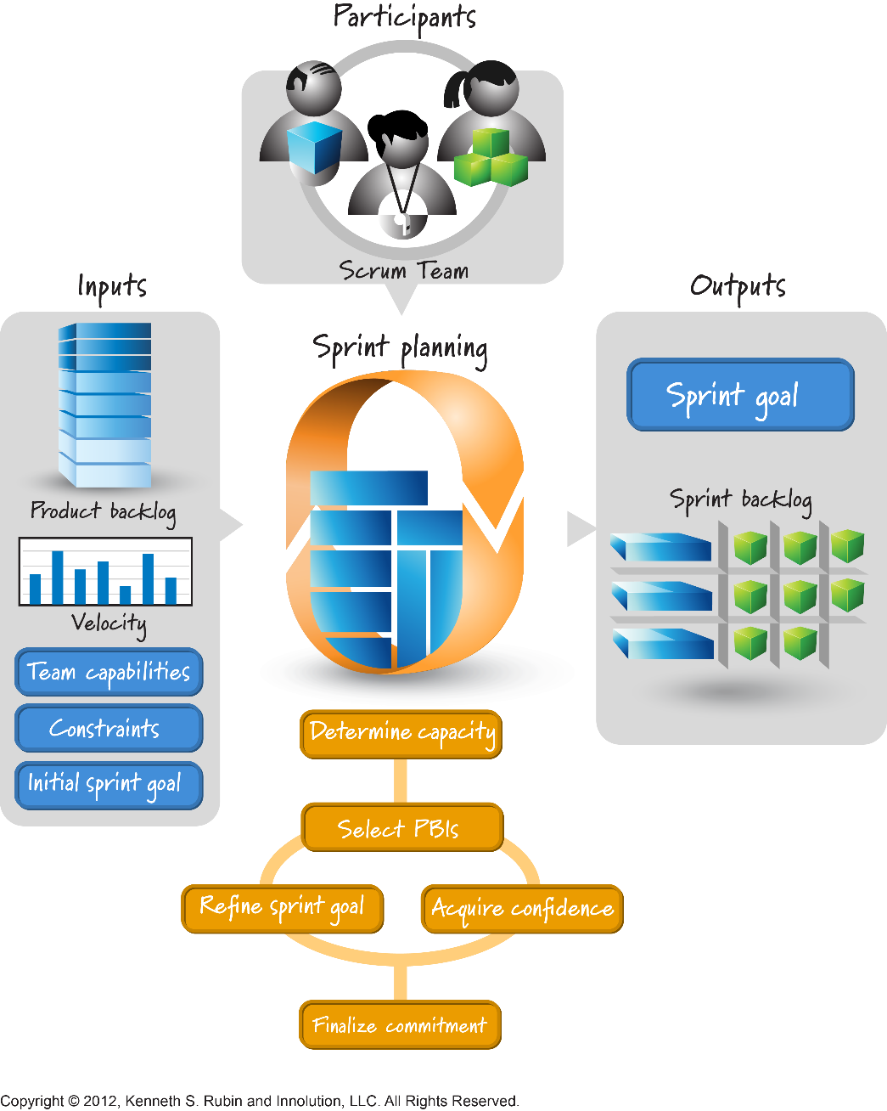
Sprint Planning Elements

Slide 24
Sprint Planning – Inputs
Product Backlog
Team Velocity
Team Capacity – number of days and number of hours per day
Initial Sprint Goal – can be an overall goal like “Show top-selling products on the homepage” or can be a list of identified product backlog items
Team’s Definition of Done

Slide 25
Sprint Planning Process
Development Team members review the sprint goal and identify the product backlog items they think can be completed during the sprint talking with the Product Owner if there are any questions
Development Team members divide up the work. Only Development Team members take work and only they determine who will work on what
Development Team members determine an estimate of effort required for their work. This can be in hours or days but should be at a task level.
Try to keep tasks to only a couple hours or one day at most. This can be improved by having smaller product backlog items. The smaller the task the less risk involved.

Slide 26

Sprint Backlog
The result of the sprint goal and tasks associated with each product backlog item is the sprint backlog.
The sprint backlog shows what the team will do to accomplish the sprint goal during the sprint.
Although tasks are broken down into hours or days if the team uses Story Points for estimating the two are not required to match (i.e. 8 story points = 16 hours)
Notes:
Select a sub set of the backlog that the team feels they can complete and break them into hourly tasks
Be ware of any tasks over 8 hours, encourage the team to separate those down into smaller tasks
No one usually knows what they are going to do in 8 hours

Slide 27
Capacity
As part of sprint planning the team needs to make sure they do not take on more work than they have capacity
Team capacity can be determined as hours or days if tasks are planned that way. The team makes sures to not plan more work than they have capacity to complete.
Notes:
Select a sub set of the backlog that the team feels they can complete and break them into hourly tasks
Be ware of any tasks over 8 hours, encourage the team to separate those down into smaller tasks
No one usually knows what they are going to do in 8 hours

Slide 28
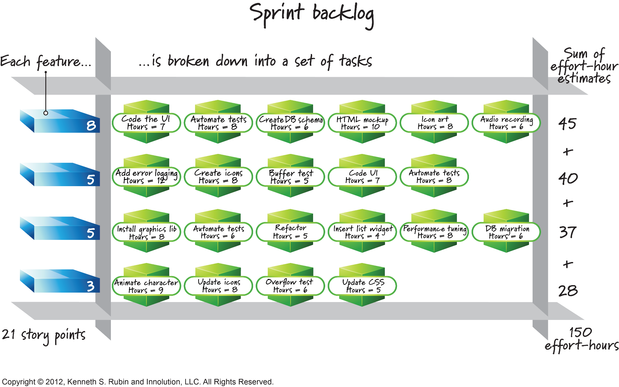
Sprint Backlog

Slide 29
Additional Resources
Sprint Planning (Mike Cohn)
https://www.youtube.com/watch?v=En3ifkDYgHM&t=28s
(length 3:20)

